Slide 1
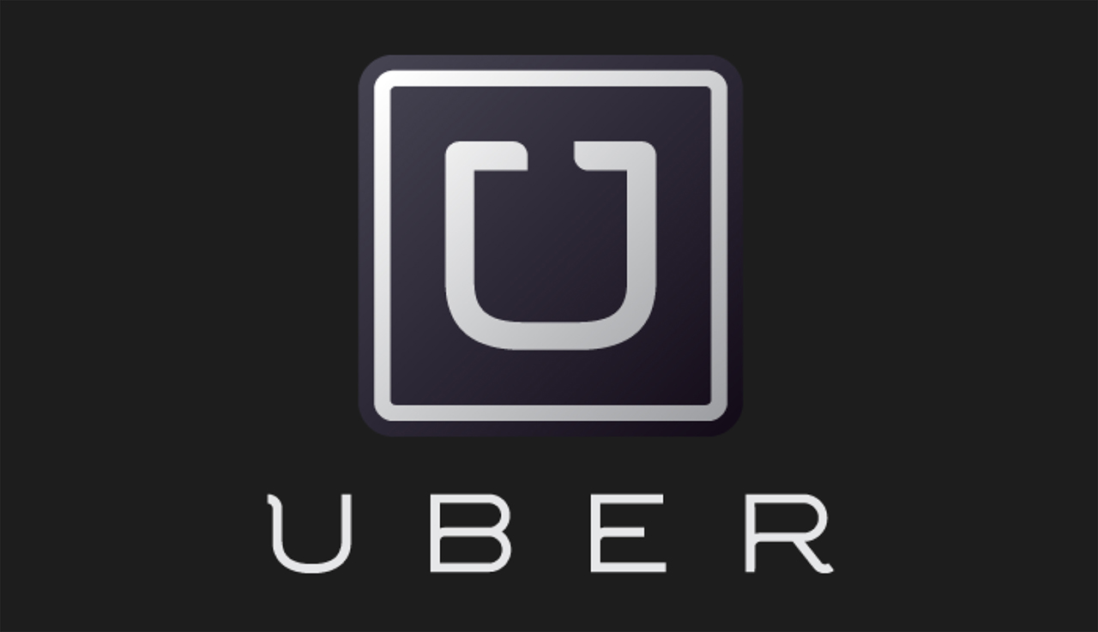
TEAM 3
Notes:
Uber is a technical company, not a taxi company, providing carpool service.
At first glance, Uber may seem unrelated to high-tech, but it is actually an IT company.
Although they provide beautiful apps and websites, we need to pay attention to big data analysis and the use of artificial intelligence.
In other words, technology is being used in areas that users cannot see directly, and service quality is being improved. Uber is also using other technologies to:
– A system in which the price changes in real time according to the supply-demand balance – Real-time visualization of the driving situation of Uber on the street

Slide 2
More than 20 various services
Notes:
Now, Uber is a global giant company providing not only Uberpool, UberEats, also Providing more than 20 various services.

Slide 3
Books
$ 90 billion books , 2021
Uber 2021
118 million Users by year
Revenue
$18.3 billion revenue, 2021
Notes:
generating $18.3 billion revenue, $90 billion books by year, and having about 118 million users.

Slide 4
Background
Utilizing ML
Solutions
Opportunity
& Challenge
ML-related
Business Problem
Benefit & Cost

Slide 5
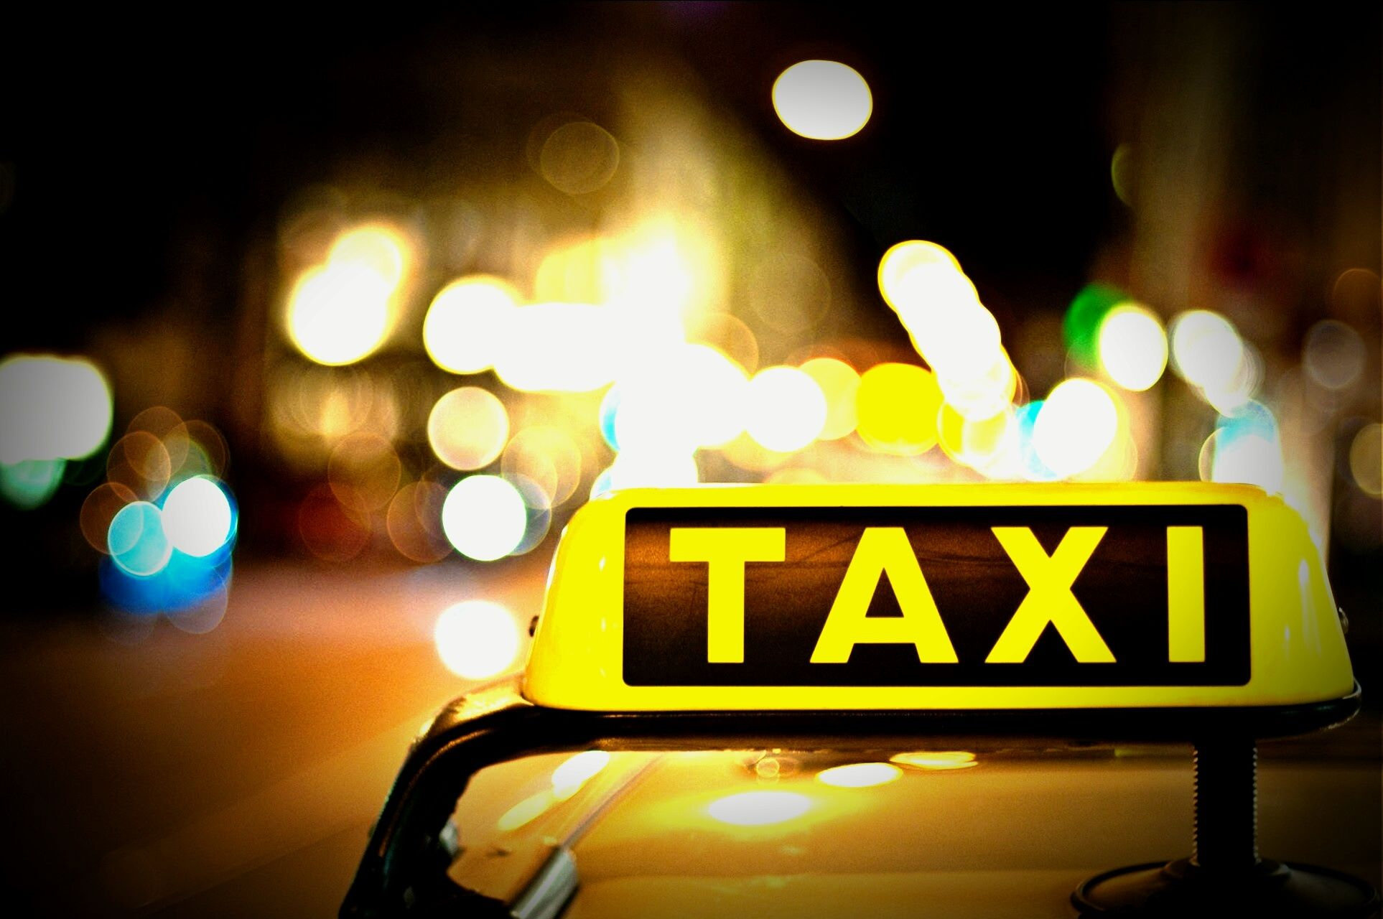


Background
Background
Utilizing ML
Solutions
Opportunity
& Challenge
ML-related Business problem
Benefits
& Costs
Traditional Taxis
Long waits
Rude drivers
Unreasonable price
Lack of route transparency
Unpredictable arrival time
All the shortcomings of traditional taxis were the opportunities for Uber

Slide 6



Opportunity
Background
Utilizing ML
Solutions
Opportunity
& Challenge
ML-related Business problem
Benefits
& Costs
The explosive growth of AI technology, GPS navigation, smartphones
And rise of the sharing economy concept.
Notes:
Not only the shortcomings of traditional taxis, there were huge opportunities for Uber.
Growth of technology, GPS navigation, smartphones, and Rise of the sharing economy concept.

Slide 7
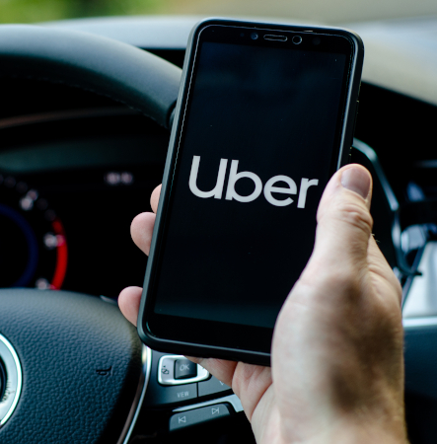




Opportunity
Background
Utilizing ML
Solutions
Opportunity
& Challenge
ML-related Business problem
Benefits
& Costs
Ride Sharing Platform
Uber App
Notes:
Uber had pioneered the growth and delivery of modern ridesharing services by leveraging the explosive growth of technology, GPS navigation, and smartphones.
Ride-sharing is a mobility service based on the sharing economy, in which people with similar travel routes ride together in one car. Ride-sharing can be used for people who cannot drive, and it has the advantage of benefiting car owners.
The uber’s ridesharing services had expanded across the world, growing rapidly in the United States, China, India, Europe, and Southeast Asia.
Ref : https://www.emerald.com/insight/content/doi/10.1108/case.kellogg.2021.000090/full/html?skipTracking=true#undefined

Slide 8
Challenge
Background
Utilizing ML
Solutions
Opportunity
& Challenge
ML-related Business problem
Benefits
& Costs
Difficulties on handling
with huge data
Need to draw not only customer,
but also driver into uber platform
, solving problems inherent in traditional taxi service
Notes:
Surely, there were challenges.
what skills Uber needed for the service?
-
- To make Uber as data-driven as possible, they needed to ensure that analytical data was accessible to analysts, all in one place.
Prior to 2014, all of the company’s data could fit into “a few traditional online transaction processing (OLTP) databases (in [their] case, MySQL and PostgreSQL ).” At that time, engineers were required to write individual code to access and join data across databases, a take made more difficult by the fact that there was no global view of all stored data, which was scattered around several OLTP databases with a “total data size on the order of a few terabytes.”
----------------------------------------
Pickups were complicated by traffic congestion, faulty GPS signals, and crowded pickup venues. Flawed pickups resulted in rider dissatisfaction and in lost revenues for drivers.
It need to be quickly calculated that users and which users will be riding together. What is needed for this is to calculate the optimal route at high speed and accurately predict the arrival time.
In urban areas, the travel time of a car is often more dependent on traffic congestion than distance, and the congestion situation changes in real time. If the optimal route calculation and accurate time prediction cannot be realized at high speed, the following problems occurred in Uber service.
- It takes time to match the driver.
- It needs to suggest the price reasonable for both sides, rider and driver
-
Ref : http://www.withpress.co.kr/archives/2866

Slide 9
Challenge
Background
Utilizing ML
Solutions
Opportunity
& Challenge
ML-related Business problem
Benefits
& Costs
Difficulties on handling
with huge data
Need to draw not only customer,
but also driver into uber platform
, solving problems inherent in traditional taxi service
How to match
How to price
Notes:
Surely, there were challenges.
what skills Uber needed for the service?
-
- To make Uber as data-driven as possible, they needed to ensure that analytical data was accessible to analysts, all in one place.
Prior to 2014, all of the company’s data could fit into “a few traditional online transaction processing (OLTP) databases (in [their] case, MySQL and PostgreSQL ).” At that time, engineers were required to write individual code to access and join data across databases, a take made more difficult by the fact that there was no global view of all stored data, which was scattered around several OLTP databases with a “total data size on the order of a few terabytes.”
----------------------------------------
Pickups were complicated by traffic congestion, faulty GPS signals, and crowded pickup venues. Flawed pickups resulted in rider dissatisfaction and in lost revenues for drivers.
It need to be quickly calculated that users and which users will be riding together. What is needed for this is to calculate the optimal route at high speed and accurately predict the arrival time.
In urban areas, the travel time of a car is often more dependent on traffic congestion than distance, and the congestion situation changes in real time. If the optimal route calculation and accurate time prediction cannot be realized at high speed, the following problems occurred in Uber service.
- It takes time to match the driver.
- It needs to suggest the price reasonable for both sides, rider and driver
-
Ref : http://www.withpress.co.kr/archives/2866

Slide 10





Utilizing ML : Dynamic Pricing
Background
Utilizing ML
Solutions
Opportunity
& Challenge
ML-related Business problem
Benefits
& Costs
Dynamic Pricing
ML Model
Notes:
Dynamic, or so-called surge, pricing is a key part of the business model of Uber
In its entity, Uber relies extensively on machine learning (ML) to establish a robust and reliable dynamic pricing system. With the help of ML, Uber generates a future-aware forecast of multiple conditions of the market and uses a system that is very sensitive to external factors: these factors ultimately include the global news events, weather, historical data, holidays, time, traffic, etc.
However, what happens if there is not enough information for making a prediction?
Ref : https://eng.uber.com/machine-learning/

Slide 11

Utilizing ML : Dynamic Pricing
Background
Utilizing ML
Solutions
Opportunity
& Challenge
ML-related Business problem
Benefits
& Costs
Dynamic Pricing
ML Model
LSTM
Unexpected
Notes:
For preventing the event, there is little or no data at all, Uber exploits LSTM (long short-term memory) networks as well as deep learning models to predict the future stance of the market and even the “unexpected” events before they can happen.
To clarify, LSTM’s are building blocks for layers of a recurrent neural network (RNN), the one that allows information to persist. All of the LSTM’s are adapted for classifying, learning, and predicting time series, even if there are time lags between important events. By using LSTM’s, Uber ultimately allows itself to effectively calculate and analyze all of the needed variables to form a price that would reflect the current state of the market and optimize the overall experience.
Without doubts, dynamic pricing algorithms lie at the core of Uber market success, especially since they solve a multitude of problems while simultaneously benefiting both the industries and the customers (at least, on paper).
Ref : https://eng.uber.com/machine-learning/

Slide 12


Utilizing ML : Batched matching
Background
Utilizing ML
Solutions
Opportunity
& Challenge
ML-related Business problem
Benefits
& Costs
Only distance-based matching
is not always best case
ML-based batched matching system
finds the best matching rider-driver
The reasonable matching system using machine learning provided irreplaceable convenience to both customers and riders.
Notes:
Also,
Matching riders and drivers is a core component of what makes Uber so successful.
One way of matching riders and drivers is to match the closest driver with the closest rider. However, Uber's engineer figured out this is not always the best case.
They also developed algorithm using ML to match riders to drivers.
Their dispatch algorithms look at thousands of features in real time to generate more than 30 million match pair predictions per minute.
This is a massively complex problem since we must consider distance, time, traffic, direction, and other real-world dynamics as well as deeply understand the experience drivers and riders desire.
A combination of tree-based models, ensembling techniques, and match optimization methods are used to ensure an optimal trip experience.
The reasonable matching system using machine learning provided irreplaceable convenience to both customers and riders.
In fact, innovations in Uber’s matching algorithms for back-to-back trips have saved many years of time each week in aggregate for our riders and drivers.

Slide 13
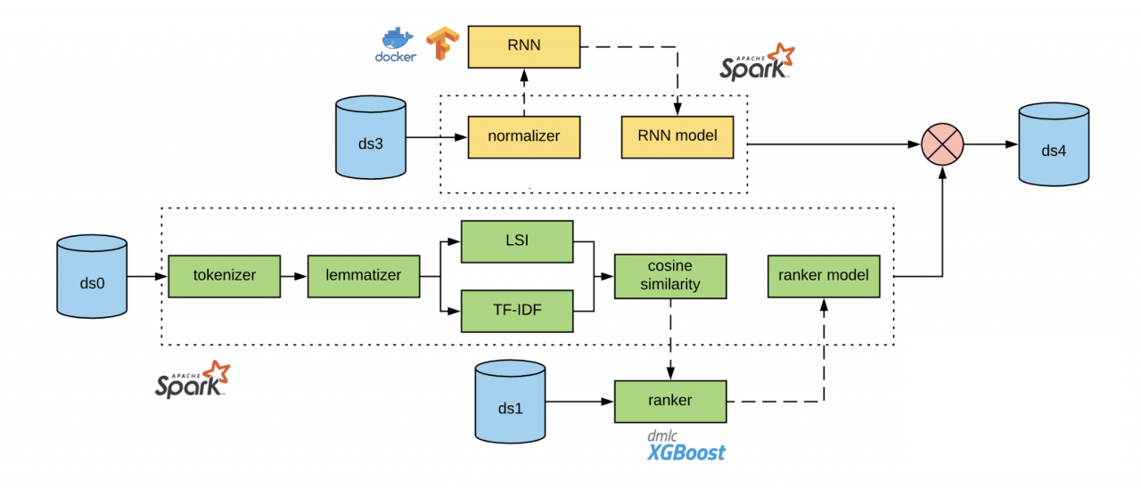

Utilizing ML : ML Platforms
Background
Utilizing ML
Solutions
Opportunity
& Challenge
ML-related Business problem
Benefits
& Costs
Michelangelo
Notes:
And after
To rapidly build models and algorithms that leverage the massive amounts of aggregated data processed from Uber’s services,
they have built several data science platforms. These platforms enable their data scientists to create technologies that increase the effectiveness and efficiency of our products and operations.
Representatively, Michelangelo, Uber's machine learning platform designed to cover end-to-end machine learning workflows, currently supports training and servicing of its thousands of models.
-----------additional info------------------------
The main open source components used in Michelangelo of Uber are 'Hadoop Distributed File System’ for reliable and scalable distributed computing, and integration for large-scale data processing.
Analysis engine 'Spark', streaming processing engine 'Samza’,
open source database (DB) Apache 'Cassandra', machine learning library MLLib ,
achine learning algorithm 'XGBoost(eXtreme Gradient Boosting)' ', and TensorFlow.
----------------------------------------------------------
Michelangelo, Uber’s ML-as-a-service platform, allows users at the company to query data, generate features, and apply a host of ML models to solve problems in production. Advanced Technologies Group (ATG), who develop our self-driving vehicle technologies, UberEATS, Advertising, and Marketing are just a few of the teams that leverage this powerful platform.
Another example of our ML-enabled technology includes our Natural Language Processing (NLP) platform, which generates and deploys actionable responses for our customer support tickets, chatbots to make driver onboarding easier, and suggested in-app replies. With our commitment to our driver partners, we have been using our NLP platform along with deep learning models to improve the recommended actions and turnaround times for our support tickets.
Ref : https://eng.uber.com/machine-learning/

Slide 14
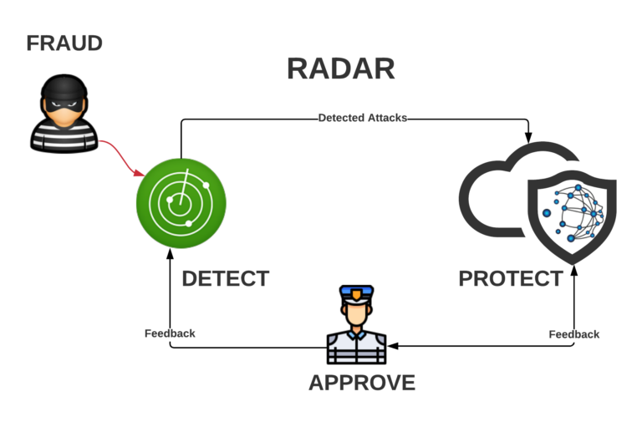
Business Problem: Payment Fraud
Background
Utilizing ML
Solutions
Opportunity
& Challenge
ML-related Business problem
Benefits
& Costs
2 Types of Payment fraud
DNS(Do not settle)
Chargeback
Notes:
And then, I am going to talk about business problem of Uber.
Frist of all, Payment Fraud.
Uber is a worldwide marketplace of services, processing thousands of monetary transactions every second.
payment fraud losses are measured in terms of the fraction of gross amounts processed. Though only a small fraction of gross bookings, these losses impact profits significantly. Furthermore, if a fraudulent activity is not discovered and mitigated immediately, it could soon be further exploited, resulting in serious losses for the company. These dynamics make early fraud detection vital to the company’s financial health.
Following are the 2 primary payment fraud types that we are concerned with:
DNS stands for “do not settle”, which occurs when the order has been fulfilled or a trip has been completed, but the payment could not be collected
Chargeback happens when the payment has been collected, but the user disputes the transaction, and the bank refunds the money
In both cases, the losses detected change over time. If an analyst analyzes losses from transactions made on one day, these losses can change depending on what day they look at the data. This is because the data may not be fully mature. Payments that are initially uncollected can be collected after the date of the transaction. Alternatively, users may only choose to dispute losses days or weeks after the initial transaction date. Therefore, losses for a single day may increase or decrease over time. However, when enough time has passed from the initial transaction date, the fluctuations in losses will be minimal, and these losses are termed fully mature.
Therefore, when analysts see early spikes in immature losses, they need to make a judgment call on whether or not these spikes are due to increased activity on the platform, or are signals indicative of fraudulent activity.

Slide 15
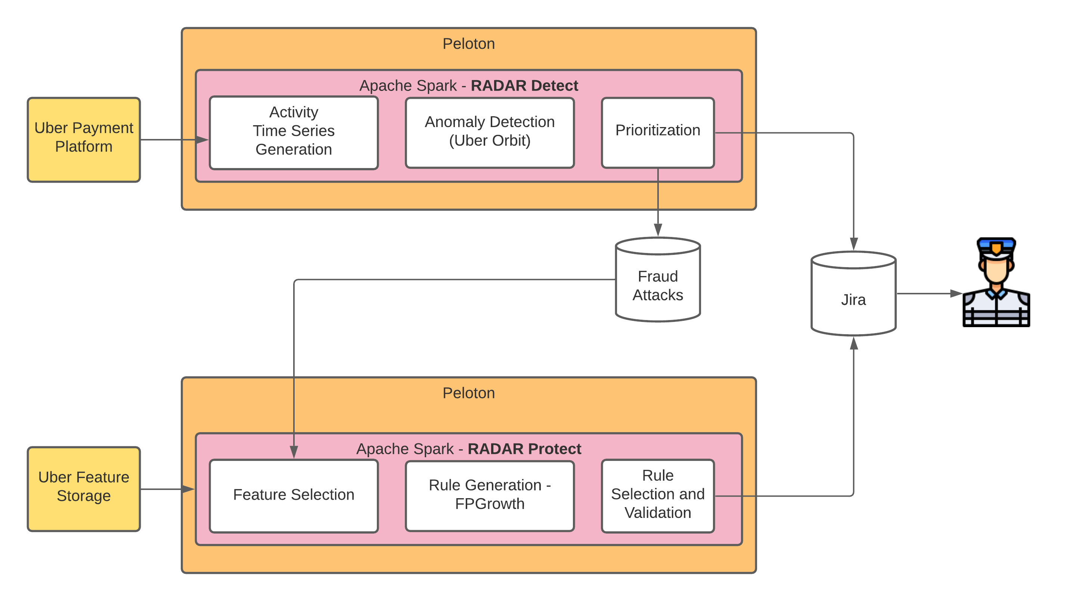
Solution: Payment Fraud
Background
Utilizing ML
Solutions
Opportunity
& Challenge
ML-related Business problem
Benefits
& Costs
Radar
AI fraud detection and mitigation system with humans in the loop
Notes:
Then, how to solve this problem?
Uber use “Radar” system.
Radar is AI fraud detection and mitigation system with humans in the loop.
RADAR monitors fine-grained segments of Uber’s marketplace, detects the start of a fraud attack, and generates a rule to stop it. The fraud analysts are involved to review the rule and approve it as needed.
RADAR detects fraud attacks by analyzing the activity time-series from the Uber payment platform and converts data insights into human action.
It looks at the data in 2 different time dimensions. We will define some terminology to discuss time series data below:
OT – “Order time” when the specific order has been fulfilled.
PSMT – “Payment settlement maturity time” signifies the time when the payment processing data comes in. Depending on the specific payment processing system the payment can take days and weeks to completely settle.
Orbit is an open-source Python® package for Bayesian time series modeling. It implements a suite of structural Bayesian time series models while providing a general interface for Bayesian time series forecasting. This package is written and designed from a strict object-oriented perspective with the goals of reusability, ease of maintenance, and high efficiency.
RADAR uses the KTR (Kernel-based Time-varying Regression) model inside orbit for training, inferences, and forecasting of time series models.
We build the time series decomposition model for each one-dimensional time series in the OT dimension for each aggregate signal and for each PSMT slice.
We use the Uber Orbit model as described above for time-series forecasting in OT dimension used to establish the anomaly baseline.
Therefore, after we detect these anomalous losses, we need to project them to full maturity in order to predict how they will settle over time. Now we use the PSMT dimension to forecast the losses. We are using the losses from historical data to produce this forecast.
And then, use Jira as a feedback loop mechanism.
After filtering all risk features, Uber finds patterns to generate rules.
the important lesson to learn from this project is that successful implementation of machine learning projects requires bringing together technology, data, algorithms, and people. Our system serves humans and has humans in the loop.
Uber risk analysts play a very important role in this process and this technological solution would not be possible without their involvement and continued feedback.

Slide 16



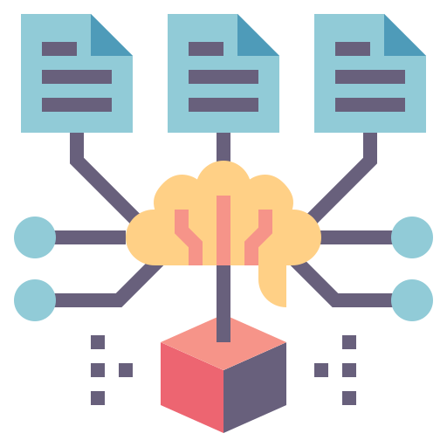
Business Problem: Capacity Safety
Background
Utilizing ML
Solutions
Opportunity
& Challenge
ML-related Business problem
Benefits
& Costs
Notes:
As Uber’s global mobility platform grows, our global scale and complex network of microservice call patterns have made capacity requirements for individual services difficult to predict. When we’re unable to predict service-level capacity requirements, capacity-related outages can occur. Given the real-time nature of our operations, capacity-related outages (affecting microservices at the feature level as opposed to directly impacting user experiences) constitute a large chunk of Uber’s overall outages.

Slide 17
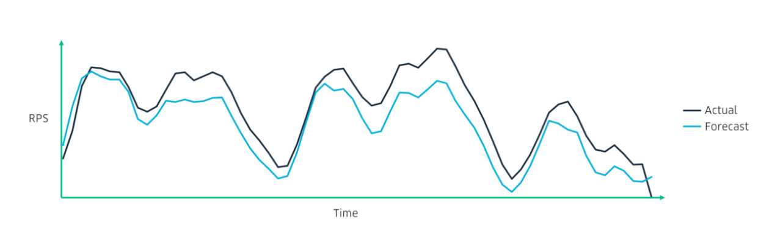
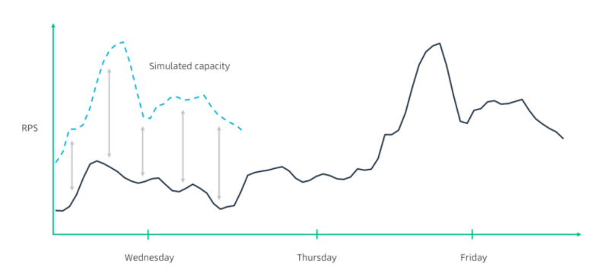
Solution: Capacity Safety
Background
Utilizing ML
Solutions
Opportunity
& Challenge
ML-related Business problem
Benefits
& Costs
Predict core metrics and Simulate
e.g.) requests per second, latency, and CPU usage
Notes:
Then, how could Uber solve this problem?
To help prevent these outages, Uber’s reliability engineers abide by a concept called capacity safety, in other words, the ability to support historical peaks or a 90-day forecast of concurrent riders-on-trip from a single data center without causing significant CPU, memory, and general resource starvation.
Fidelity is the notion that all critical services are tested in the same manner as they would be by natural traffic. Top-level microservices are tested thoroughly, but deep back-end microservices like mapping systems and payments services do not receive similar coverage. Additionally, in order to provide a controlled testing environment, platform-wide stress tests lock down the entire deployment system. As expected, this has a negative impact on the developer experience since it stalls ongoing builds and deployments.
So, they query, preprocess, forecast, and back-test data. They leverage an internal forecasting API that uses an ensemble method containing ARIMA, Holt-Winters, and Theta models. Each model’s prediction is taken into account with equal weight, although for future forecasting use cases, models that perform better may be weighted higher than others. Further, the forecasting API implements automatic forecasting, which fine-tunes model hyperparameters without manual input.
The goal of our prediction system is to streamline the process of forecasting important metrics, conducting local capacity safety drills, and receiving feedback as to whether a service is correctly provisioned.
We need two broad sets of statistical techniques, one for preprocessing and another for forecasting. Ensemble-based models are also powerful for inculcating the perspectives of various models.
Because this system not just detect abnormality, but forecast capacity,

Slide 18



Business Problem: Others
Background
Utilizing ML
Solutions
Opportunity
& Challenge
ML-related Business problem
Benefits
& Costs
Law issues
Privacy
Price competition
Notes:
And then, there are several other business problems.
Law issues, privacy, and price competition, and etc.

Slide 19




Benefit & Cost
Background
Utilizing ML
Solutions
Opportunity
& Challenge
ML-related Business problem
Benefits
& Costs
Cost of
Big Data
Rely
Extensively
On ML
Productivity Improvement
Reliability
Notes:
Benefits
The estimated improvement in business productivity by using AI is 54%.
62% of customers are willing to submit their data to AI for a better business and user experience.
Since objective results are derived by analyzing data, users' trust can be obtained.
Costs
Cost of Big data
Big data is at the core of Uber’s business. We continue to innovate and provide better experiences for our earners, riders, and eaters by leveraging big data, machine learning, and artificial intelligence technology. As a result, over the last four years, the scale of our big data platform multiplied from single-digit petabytes to many hundreds of petabytes.
The cost of running our big data platform also rose significantly. It takes a lot of money to collect and process data because it deals with a huge amount of real-time data.
Rely extensively on ML
In its entity, Uber relies extensively on machine learning (ML) to establish a robust and reliable dynamic pricing system. With the help of ML, Uber generates a future-aware forecast of multiple conditions of the market and uses a system that is very sensitive to external factors: these factors ultimately include the global news events, weather, historical data, holidays, time, traffic, etc.

Slide 20
Team 3
Thank you!

